Slide 1

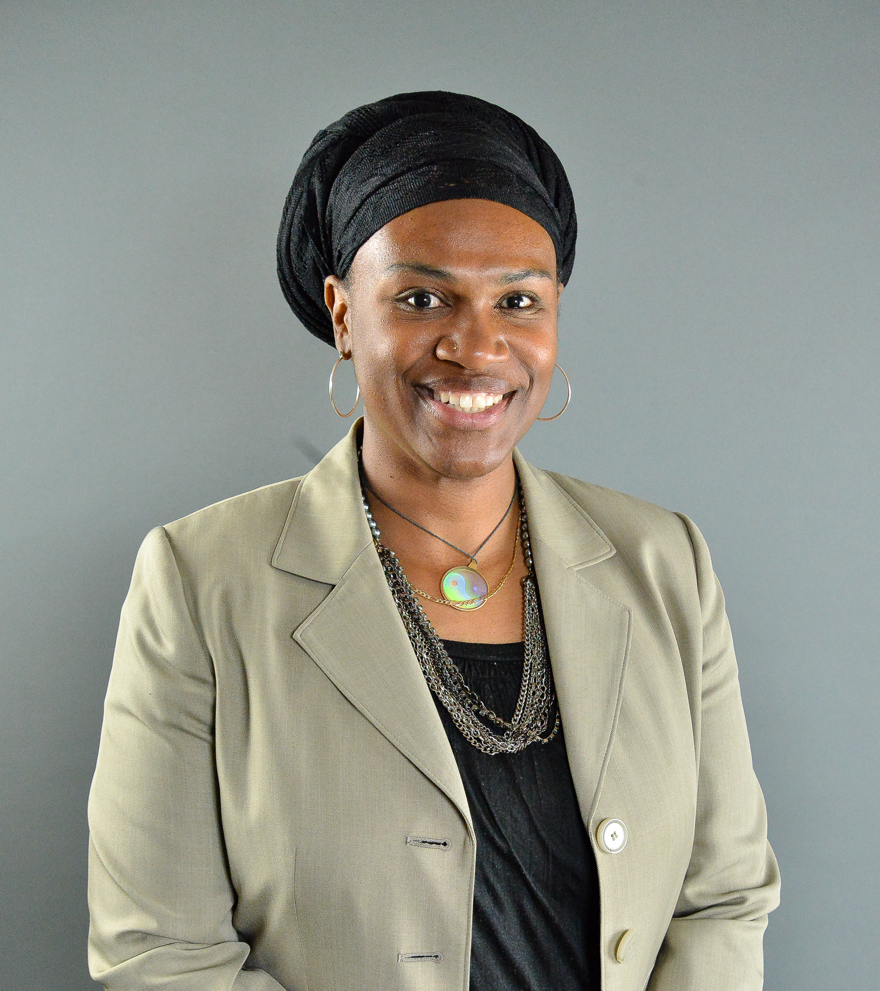


How Business intelligence is smart.
Racheal Lane
Senior Manager - Business Intelligence
Comcast Cable - Western New England Region
@rlanecomcast
linkedin.com/in/racheal-lane

Slide 2

Discussion topics:
What makes my team special
Farm to table
Data vs Insights
The Future of BI
@rlanecomcast

Slide 3
When you think of Business intelligence what image comes to mind?
@rlanecomcast
Notes:
When I started to think content for this talk, I contemplated the theme “Owning the Room & Sharing your Value"
In addition to my contribution to the business I feel much of my value comes from being able to pave the way for others coming after me.
This got me thinking of how I got here. What made me land on Busines Intelligence as a career.
I stopped and thought to myself – I don’t know how I got here. It wasn’t intentional.
Then I thought – wow that’s not good. I’m supposed to speak about what my road map and journey that may inspire others to think about following the same path.
But I never saw anyone like me or looked like me doing what I do. Currently, I still do not see anyone like me or who looks like me doing what I do.
So, prepping I checked. I Googled images of business Intelligence professionals to see what is out there. This is what I found.

Slide 4


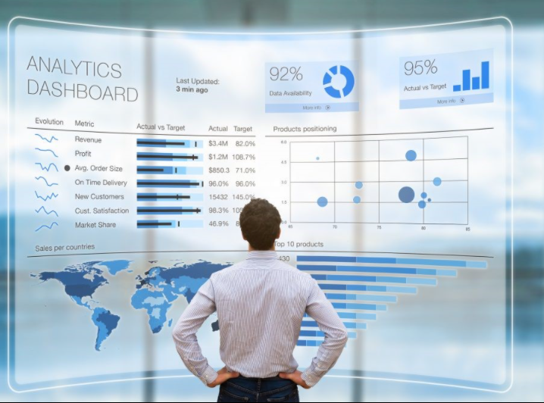

@rlanecomcast
Notes:
I found this, then this and others like it, Then this, then finally saw some women.
I didn’t see one black man or black women. And we know the expression you can’t be what you can’t see
I asked the question again, how did I get here?

Slide 5

@rlanecomcast
Notes:
Let me know now formally introduce myself.
My name is Racheal Lane - I’m a person of Faith, a Wife, a Mother, a Grandmother and fundamentally a Puzzle solver
From when I could remember I was fascinated by puzzles. When I was 15, I could solve the Rubik’s cube in 3 min and 35 secs. The Rubik’s revenge (4 tier) in 4 mins and 15 sec.
As much as I love puzzles
Fun fact.. I’m horrible at word scrambles though.
Being a puzzle solver that led me to career where puzzle solving is the driver of success

Slide 6

“If you are curious, you’ll find the puzzles around you. If you are determined, you will solve them.”
--Erno Rubik
“A good puzzle, it’s a fair thing. Nobody is lying. It’s very clear, and the problem depends just on you”
--Erno Rubik
@rlanecomcast
Notes:
Erno is the inventor of Rubik’s Cube and his second quote I especially love because I start with that premise when I think about what I do here at Comcast. Solve a good puzzle. One that is clear, clean and if I work hard at it, I can solve.

Slide 7
I work with a team of puzzle solvers
@rlanecomcast
Notes:
This skill set / quality I have has also led me to other like minding people.

Slide 8
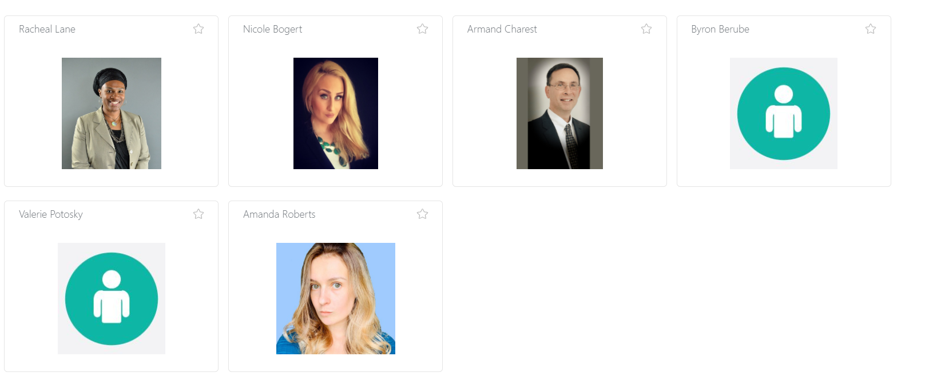
Western New England REGION
Business Intelligence team
Racheal Lane
Nicole Bogert
Armand Charest
Byron Berube
100+ Requests
1,500+ Queries
750k+ Lines of Code
100+ Staging tables
35+ Automation routines / Visualization views
Valerie Potosky
Amanda Roberts
We assist the regional functions and stakeholders by way of analysis and recommendations to improve employee performance, increase subscriber volume, drive down churn, reduce expense and improve the customer experience.
@rlanecomcast
Notes:
Meet the puzzle solvers of the Western New England Region! Nicole Bogert, Armand Charest, Byron Berube, Valerie Potosky and Amanda Roberts.
What makes my team special is that we look at the business from a macro level
- Looking at the goals of the Region and seeing what might get in the way of those goals.
When look at the KPI’s or Key Performance Indicators and measures we then highlight the best practices, show the challenges or gaps and expose the outliers (good and bad)
This then helps the organization produce strategies and innovations to bring about change that will be sustainable and, in some cases, scalable.

Slide 9
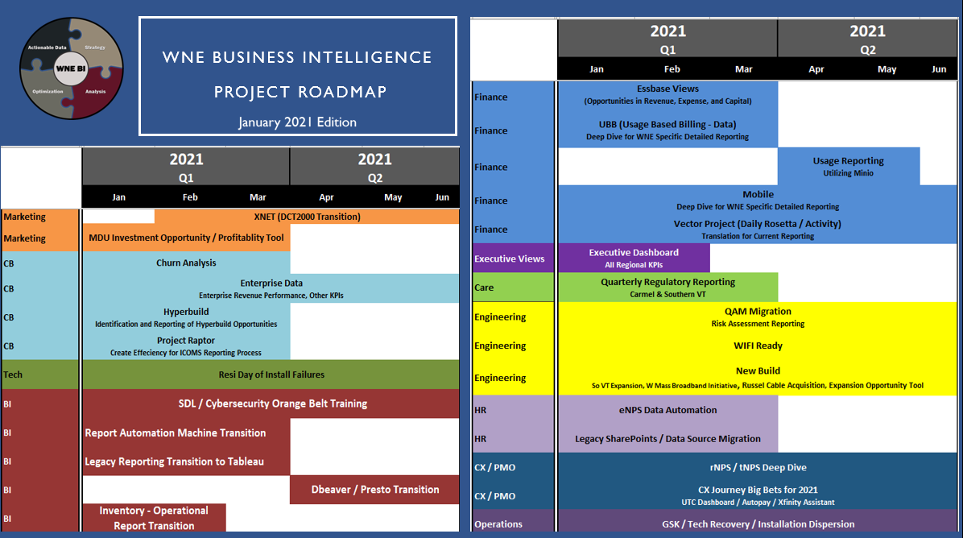
@rlanecomcast
Notes:
Here is our list of projects for the front half of 2021.
(List the departments)
How did we produce this list of projects?

Slide 10


Farm to Table
How Business intelligence
is smart.
@rlanecomcast
Notes:
What makes my team special – Is they are not just data miners or programmers. We have a conversations with the Stakeholders which is sparked by our research and study of the business and we plant the seeds for the question being asked.
I will tease that out a bit.

Slide 11


How best do we increase Successful Self Install volume to achieve 2021 budget goals?
stake holder this with key decision makers
@rlanecomcast
Notes:
Here’s a seed - while looking at the goals for the new year - One of which was the complete more Self Installs - How best do we increase Successful Self Install volume to achieve 2021 budget goals?

Slide 12

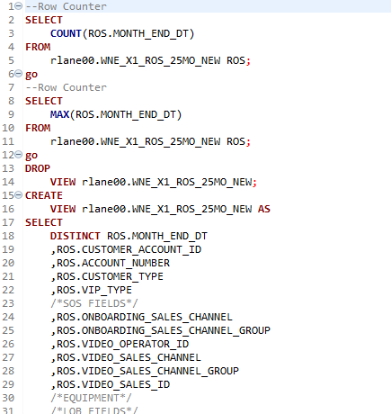
Write the Code - SQL
@rlanecomcast
Notes:
Here is where we get in there do the work. Scrub out any errors, aggregate where possible and harden the data to make it useful

Slide 13


Vet the Code
Compare output to established Truths or Precedent
data of record to be widely or permanently accepted
– Collins Dictionary
Also, be prepared to Reset Data Expectations
@rlanecomcast
Notes:
Look at the information the code represents from all possible angles and established truths. Established truths are data points the region has accepted as being fact. For instance, our Self Install rate is approx. 65%. If our data showed only 20% we would know something needs to be adjusted. One note this exercise might uproot data points that were once known as truths and bring about new insights otherwise known as resetting expectations
We will talk about insights in a minute.

Slide 14

Stake Holder (Again)
Widen the audience and Exposure
@rlanecomcast
Notes:
Bring others into the conversation. People who will use the data on the ground and who might be involved in operationalizing efforts to either mitigate risks which were identified in this process or scale best practices to other parts of the business.

Slide 15



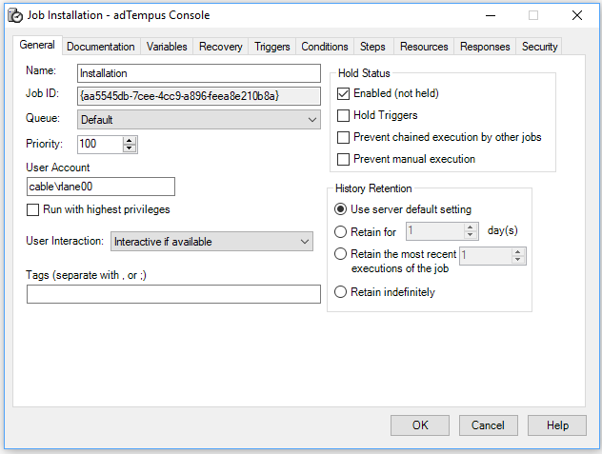
Put in place automation
@rlanecomcast
Notes:
Once the code is written and it's agreed the data is accurate, we automate the routines as much as possible. We use a great software called AdTempus to get this done.

Slide 16
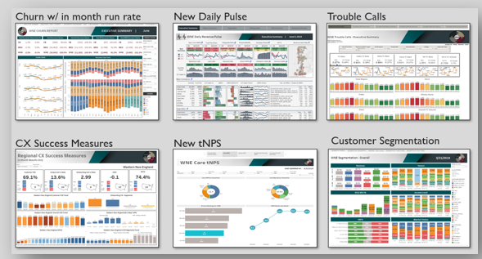

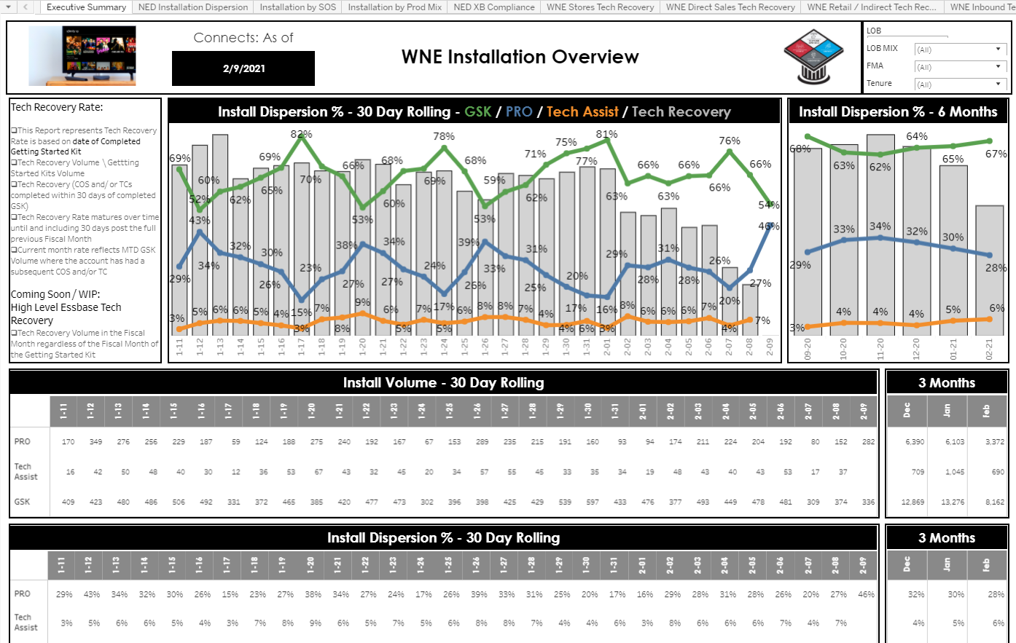
Now Comes the fun part!
Harvest the data and plate it - Tableau
@rlanecomcast
Notes:
Put together visually appealing views that are easily digested and metabolized by the audience. Make the views something someone would want to click on!

Slide 17
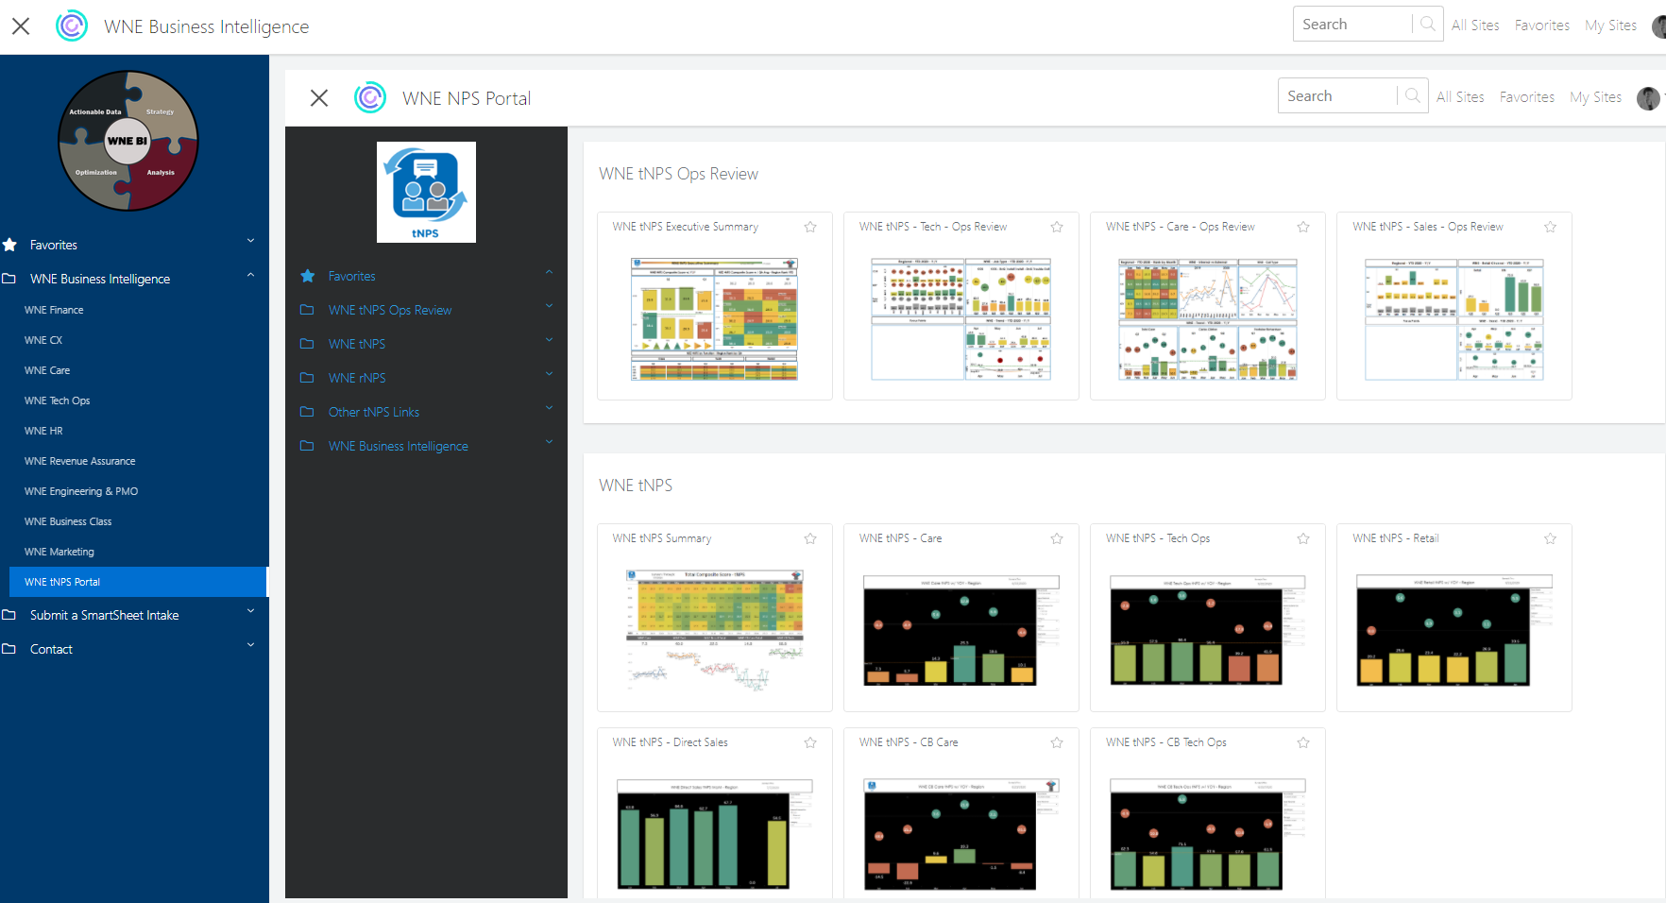


Serve it in a 5-star Restaurant – ViZ PORTAL
@rlanecomcast
Notes:
We offer a Self Serve option, by positioning our views in a place that is easily navigated. A place where our stakeholders other internal customers can enjoy and consume the products we offer.

Slide 18
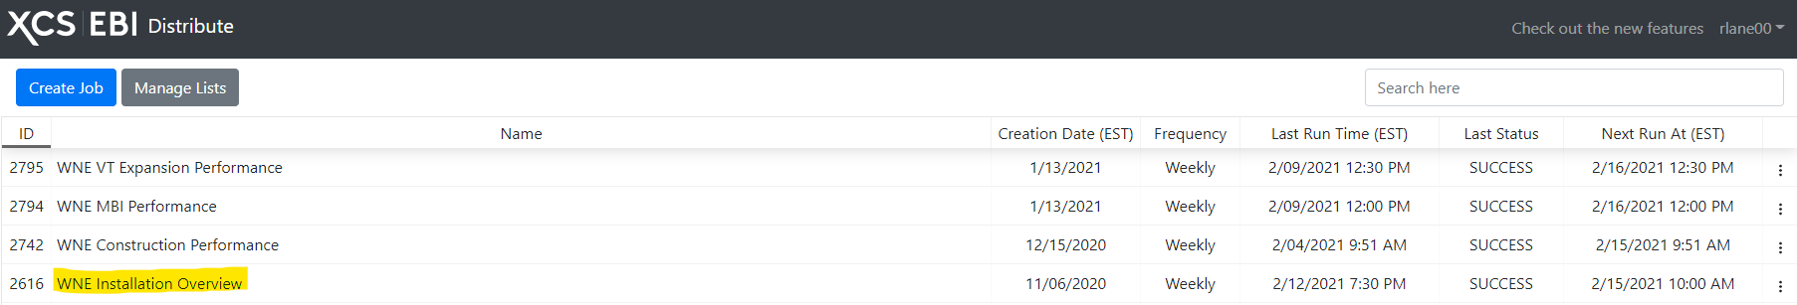

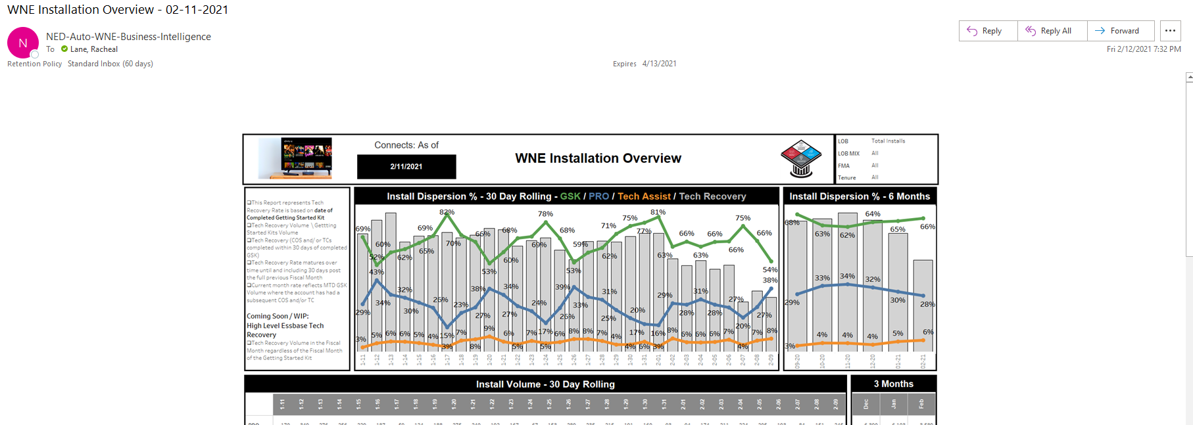
Add Convenience – Distribute app
@rlanecomcast
Notes:
To add convenience, we leverage Enterprise Business Intelligence Distribute App allows users to subscribe to our automated emails which notifies them our reports are updated.

Slide 19

Data vs Insights
Through Business Intelligence we learn:
How often do our Self Install Fail
How many open Construction Jobs we have
How our flex attachment rates compare to the other regions
How likely are our customers to have a customer experience leveraging the Xfinity App
@rlanecomcast
Notes:
Now I would like to talk about Data vs Insights
I often call data just a bowl of numbers. Many facts without context. But insights create conditions for change or action. In my region of Western New England, we use business Intelligence to gain knowledge regarding open how often our self install kits fail, if that information we can do something, how many open Construction opportunities have, we can do something, how our flex attachment rates compare to other regions which similar demographics, we can do something, or how likely our customer are to have a great customer experience due to self serving in the Xfinity app we can have the confidence to build even more surprise and delight features our customers can enjoy.

Slide 20
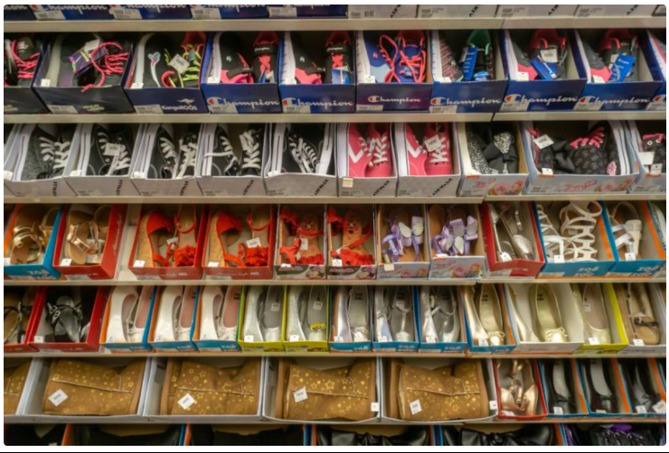
Payless shoes example
Slowed – Down Checkout
@rlanecomcast
Notes:
How Payless could have used Business Intelligence – They were looking at their data in hindsight. Perhaps if they used data insights earlier in their Lifecyle they could have thought about their strategy in a different way.
Before shuttering U.S. operations earlier this year, Payless Shoes discovered something interesting about its customers: they didn’t want a one-click, ultra-streamlined buying experience. Data from Heap showed that Payless shoppers actually preferred a two-click process, which allowed them to review their carts before purchase.
This flew in the face of conventional wisdom, which holds that fewer clicks equals a better customer experience. That principle underpinned Amazon’s two-decade-old investment in one-click buying, which it immediately patented. But not every customer wants such a streamlined experience; it depends on the clientele.
NPS Trends could have been helpful here

Slide 21


Uber example
BUSINESS INTELLIGENCE FOR RESTAURANTS
@rlanecomcast
Notes:
Uber is a great example of capitalizing on business intelligence and taking action
In 2015, when Uber launched its food-delivery app UberEATS, Uber’s interests became entangled with the interests of thousands of restaurants across the country. The mechanics of the UberEATS app also meant that Uber constantly collected business intelligence on those restaurants — which was interesting, but not particularly actionable for Uber.
So in 2016, Uber’s engineers built Restaurant Manager, a scalable, user-friendly analytics tool that gave their partner restaurants access to real-time metrics like net revenue, number of daily and weekly items sold through the app, order prep speed and basic customer satisfaction (eg., Did they give their meal a thumbs-up or a thumbs-down?) Overall, the product gave restaurant owners a clearer sense of how specific dishes tasted on certain nights.

Slide 22



The future of BI
https://www.blackillustrations.com/
@rlanecomcast
Notes:
I hope you where able learn about Business Intelligence through
What makes my team special
My fun analogy of Farm to Table
The difference between Data vs Insights
What is the future of BI? I’m hopeful that after today others like myself will be intrigue enough to think about a career in BI. Those who are puzzler solvers, love the detail, and are looking for ways to add value across many different sectors of the business, Business Intelligence is a wonderful field in which to be a part. Its true that it is hard to be what you can not see. But now you see me and the other wonderful speakers of this conference, and I hope you will see more like us in the future.

Slide 23


@rlanecomcast

